Slide 1

Federal Graduate Loans Starting Fall 2026
What master’s/PhD students, MBA candidates, and medical/professional students should know
For enrollment beginning on/after July 1, 2026 (AY 2026–27+)
Notes:
[Sources]
- https://images.unsplash.com/photo-1691630348007-b2dcb01f362f (photo background, Unsplash; accessed 2026-01-19)
[/Sources]

Slide 2




Introductions
Eddie Hill, VP
Campus Relationship Manager for Student Lending

Slide 3
Starting July 1, 2026: the big shifts
This applies to “new borrowers” for periods of instruction beginning on/after 7/1/2026
For many graduate students, federal borrowing becomes “capped” and simpler—but tighter:
Graduate PLUS is eliminated for new borrowers (no more borrowing up to Cost of Attendance).
New annual + aggregate caps for graduate vs. professional degree programs.
A new lifetime maximum aggregate limit across all levels of study ($257,500).
Repayment plan menu changes: for new loans, only Standard + the new Repayment Assistance Plan (RAP).
Legacy protection: students already borrowing for the same program by 6/30/2026 may keep current rules for up to 3 academic years (or remaining time to credential, if shorter).
Key takeaway: plan early for the “funding gap” (especially for MBA and non‑professional health programs).
This deck is educational—not legal/financial advice. Always confirm your program classification and aid package with your school.
Notes:
“Beginning July 1, 2026, we enter a completely new era of federal graduate lending. This applies to new borrowers whose programs start on or after that date.”
“For many graduate students, borrowing becomes more structured but also more limited. The biggest change is that Graduate PLUS Loans are eliminated for new borrowers. That means students can no longer borrow up to the full Cost of Attendance through federal loans.”
“Instead, students fall under new annual and aggregate federal caps, which vary depending on whether the program is considered graduate or professional.” I believe you are all in the medical professional field so your loan amounts are different than others.
“Another major shift: A lifetime federal loan limit of $257,500 now applies, which includes all borrowing across undergraduate, graduate, and professional programs.”
“Repayment options are also simplified. New borrowers will only have two choices: the Standard Plan and the new income‑based Repayment Assistance Plan—or RAP.”
The Standard Plan offers fixed payments and a repayment term that scales from 10 to 25 years depending on total borrowing amount which are scaled every 25,000 dollars. RAP becomes the only Income‑Driven Repayment plan, with payments equal to 1–10% of total AGI, a $10 minimum monthly payment, full interest subsidy, and forgiveness after 30 years.
All prior repayment plans (SAVE, PAYE, REPAYE, ICR) are eliminated for new borrowers.”**
“Finally, there is a bit of protection for current students: if they borrowed for the same program before July 1, 2026, they may keep current rules for up to three additional academic years.”
“Key takeaway: planning ahead is crucial—especially for MBA and non‑professional health programs that traditionally relied heavily on Grad PLUS funding.”

Slide 4
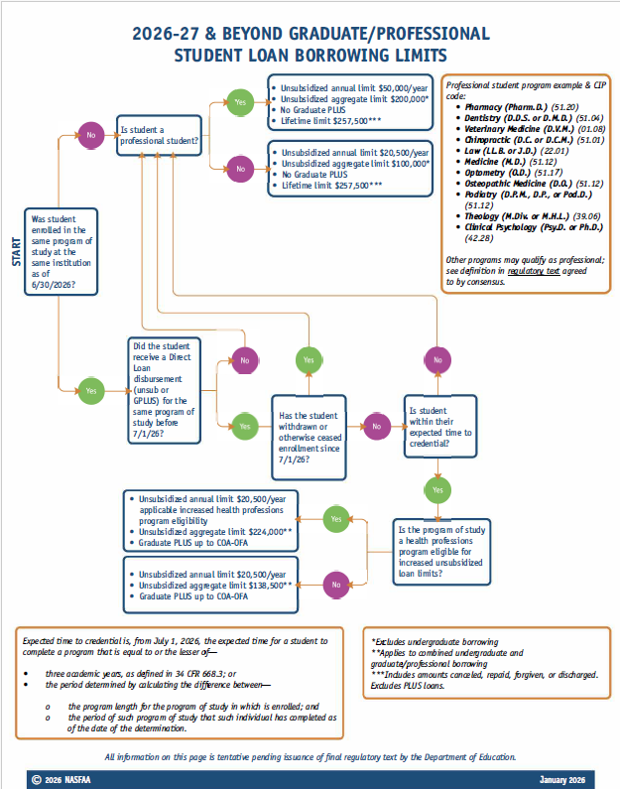
Starting July 1, 2026: the big shifts
This applies to “new borrowers” for periods of instruction beginning on/after 7/1/2026
HOW DO I KNOW?
This deck is educational—not legal/financial advice. Always confirm your program classification and aid package with your school.
Notes:
“Beginning July 1, 2026, we enter a completely new era of federal graduate lending. This applies to new borrowers whose programs start on or after that date.”
“For many graduate students, borrowing becomes more structured but also more limited. The biggest change is that Graduate PLUS Loans are eliminated for new borrowers. That means students can no longer borrow up to the full Cost of Attendance through federal loans.”
“Instead, students fall under new annual and aggregate federal caps, which vary depending on whether the program is considered graduate or professional.” I believe you are all in the medical professional field so your loan amounts are different than others.
“Another major shift: A lifetime federal loan limit of $257,500 now applies, which includes all borrowing across undergraduate, graduate, and professional programs.”
“Repayment options are also simplified. New borrowers will only have two choices: the Standard Plan and the new income‑based Repayment Assistance Plan—or RAP.”
The Standard Plan offers fixed payments and a repayment term that scales from 10 to 25 years depending on total borrowing amount which are scaled every 25,000 dollars. RAP becomes the only Income‑Driven Repayment plan, with payments equal to 1–10% of total AGI, a $10 minimum monthly payment, full interest subsidy, and forgiveness after 30 years.
All prior repayment plans (SAVE, PAYE, REPAYE, ICR) are eliminated for new borrowers.”**
“Finally, there is a bit of protection for current students: if they borrowed for the same program before July 1, 2026, they may keep current rules for up to three additional academic years.”
“Key takeaway: planning ahead is crucial—especially for MBA and non‑professional health programs that traditionally relied heavily on Grad PLUS funding.”

Slide 5

Federal loan options for graduate students (Fall 2026)
What remains after Grad PLUS is removed for new borrowers
1) Direct Unsubsidized Loan $50,000
What this means
Available to eligible professional students; not need-based.
Interest accrues from the day each disbursement is made (no subsidized portion for grads).
Subject to annual + aggregate caps (see next slide).
Your federal borrowing ceiling may be below your school’s Cost of Attendance.
Plan for grants/scholarships, institutional aid, employer tuition, savings, or private loans to cover any gap.
If you have “legacy” status, confirm how long you can keep Grad PLUS access (up to 3 academic years).
2) Grad PLUS (not available to NEW borrowers after 7/1/2026)
Before 7/1/2026, Grad PLUS could cover up to Cost of Attendance minus other aid.
After 7/1/2026: eliminated for new borrowers; only legacy borrowers may continue temporarily.
Budgeting + planning become part of the “admissions” process.
Notes:
“With Grad PLUS eliminated for new borrowers, federal aid is much more limited. The primary remaining federal loan option is the Direct Unsubsidized Loan—and even that is capped.”
“Professional students can borrow up to $50,000 annually, but most graduate students can only access $20,500 per year.”
“These loans accrue interest from day one—there is no subsidized loan at the graduate level.”
“Before July 1, 2026, Grad PLUS loans could fill the gap. After that date, only students with legacy status can continue to use Grad PLUS temporarily.”
“For new students starting your graduate program for the first time the federal borrowing ceiling will likely fall below the school’s Cost of Attendance. So it’s essential for students to consider scholarships, employer support, savings, and private students loans.”
“Budgeting and planning now become part of the admissions process—students will need a proactive strategy going into their program.”

Slide 6
Borrowing caps for new borrowers (AY 2026–27 and later)
Graduate vs. Professional degree programs
Annual + aggregate Direct Unsubsidized limits (new borrowers)
Program classification matters
“Professional degree” programs are defined by regulation referenced in the 2025 law and clarified through ED guidance/rulemaking.
If your program is not classified as “professional,” you likely fall under the $20,500 / $100,000 caps.
Ask your school’s financial aid office how your specific program is classified for AY 2026–27.
Also: a lifetime maximum aggregate limit of $257,500 applies across levels.
Dollar limits shown are principal limits for Direct Unsubsidized Loans for new borrowers. Your school may impose lower program-level limits.
Notes:
“Here’s where program classification really matters. Under the new rules, your program determines your annual and aggregate federal limits.”
“Most graduate programs—including the typical MBA—fall under the $20,500 annual / $100,000 aggregate category.”
“Professional degrees—like MD, JD, or PharmD—have higher caps: $50,000 annually / $200,000 total.”
“On top of that, the law introduces a lifetime maximum borrowing limit of $257,500 across all federal loans.”
“This means some long or high‑cost programs—especially medical and health‑science fields—may exceed what federal loans alone can cover.”
“Always remind students to check how their school classifies their program. It isn’t always intuitive.”

Slide 7


What this means for different grad tracks
Three common borrower profiles (illustrative)
Regular Grad (MA/MS/PhD)
MBA (typical case)
Medical / Professional (MD, etc.)
Borrow up to $20,500 per year; $100,000 aggregate.
Likeliest gap drivers: high tuition, living costs, longer programs.
Levers: assistantships, tuition remission, departmental funding, part-time work (if permitted).
Same caps as most graduate programs: $20,500/yr; $100,000 aggregate.
MBA tuition often exceeds federal caps → plan for school grants, employer sponsorship, or private loans.
If you borrowed federal loans for this same MBA program before 7/1/2026, ask about “legacy” status.
Professional degree caps: $50,000/yr; $200,000 aggregate.
Still commonly below full Cost of Attendance for some schools/locations.
Start mapping repayment early (residency years, PSLF-eligible employers, or aggressive payoff).
Notes:
“Let’s walk through three common student profiles to show how these caps play out.” Regular Grad (MA/MS/PhD):
“These students typically borrow at the $20,500 annual level. Their biggest challenges are tuition and living expenses—especially in longer programs. They’ll rely heavily on assistantships, stipends, and departmental funding.”
MBA Students: “Even though MBAs fall under the same $20,500 cap, MBA tuition usually far exceeds that amount. Many students will need institutional aid, employer sponsorship, or private loans to fill the gap.”
“If an MBA student already borrowed federal loans for their program before 7/1/26, they might retain legacy Grad PLUS eligibility—but only temporarily.
” Medical/Professional Students: “These students receive the higher $50,000 cap, but even that may fall short of total program costs. Early repayment planning—especially for residency or PSLF pathways—becomes essential.”

Slide 8

What is a Private Student Loan?
Borrowed funds that you must repay with interest¹
Interest rates, fees, repayment and deferment options vary greatly based on each lending institution’s loan offering
The student is usually the borrower while a parent may apply as a co-signer on the loan.
Applying with a co-signer could increase the borrower’s chance for approval and potentially lower the interest rate.
Some lenders also offer loan options for parents or sponsors to borrow on the student’s behalf, like they would with a Federal Direct PLUS Loan.
While Federal Direct Loans and Federal Direct PLUS Loans each have one standard rate for all borrowers, private loan rates are typically based on the borrowers' creditworthiness
Notes:
“Private student loans are credit‑based loans offered by banks and lenders, not the federal government.”
“They vary widely—interest rates, fees, repayment options, and deferment policies are lender‑specific.”
“Students usually apply as the borrower, and family members often serve as co‑signers, at the graduate level they may not always need a co-signer to help with credit approval or interest rate improvement. But even in my case it can help” I going to talk about Soft credit pull later is the presentation to tie this together about why.
“Some lenders also offer parent‑only or sponsor loans, similar to what the Federal PLUS Loan used to be.”
“Unlike federal loans, private loan rates are based on creditworthiness—so strong credit or a strong co‑signer can significantly reduce borrowing costs.”
.

Slide 9



Multi-Year Approval
How Multi-Year Approval could simplify college funding through graduation:
Typically, you have to reapply for student loans each year, which means another credit hit. But Multi-Year Approval means there's less stress in the long run. Here's how it works:
Apply with lender offering Multi-Year Approval
2. After your loan is approved, we'll let you know if you qualify for Multi-Year Approval.
3. If you accept your Multi-Year Approval offer, then next year there is no reapplying. If eligible, simply request the funds you need! It's that easy.
Notes:
“Multi‑Year Approval is designed to simplify the borrowing process. Traditionally, students have to reapply for loans each academic year, which means annual credit checks and additional paperwork.”
“With Multi‑Year Approval, you complete one application upfront. If the lender offers you multi‑year eligibility and you accept it, then future years become much easier.”
“Instead of reapplying, eligible borrowers simply request the amount they need—no new application, no major credit impact.”
“This is especially useful for multi‑year programs like MBAs, master’s programs, or PhDs.”

Slide 10

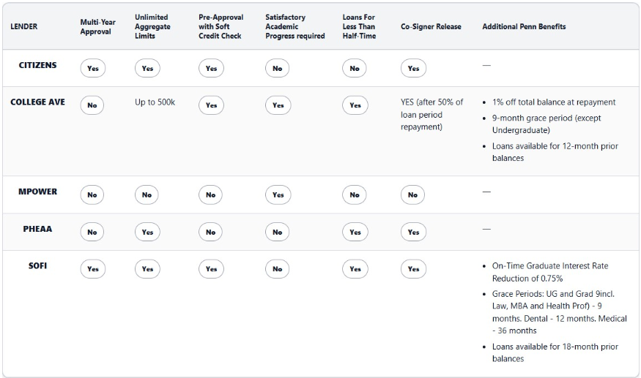
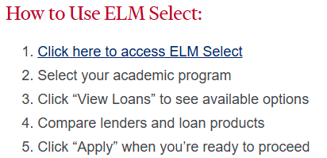
UPENN Private Student Loan Options
https://srfs.upenn.edu/financial-aid/loans/private-alternative
Notes:
“UPenn provides a curated list of private loan options on their Student Registration & Financial Services website.”
“These lenders have been vetted by UPENN vary in terms, rates, co‑signer requirements, and borrower benefits, so their students, you, do not have to do the heavy lifting on sifting through everyone who is in the private student lending space.”
“Direct them to the UPenn financial aid website for up‑to‑date lender comparisons and eligibility criteria.”

Slide 11
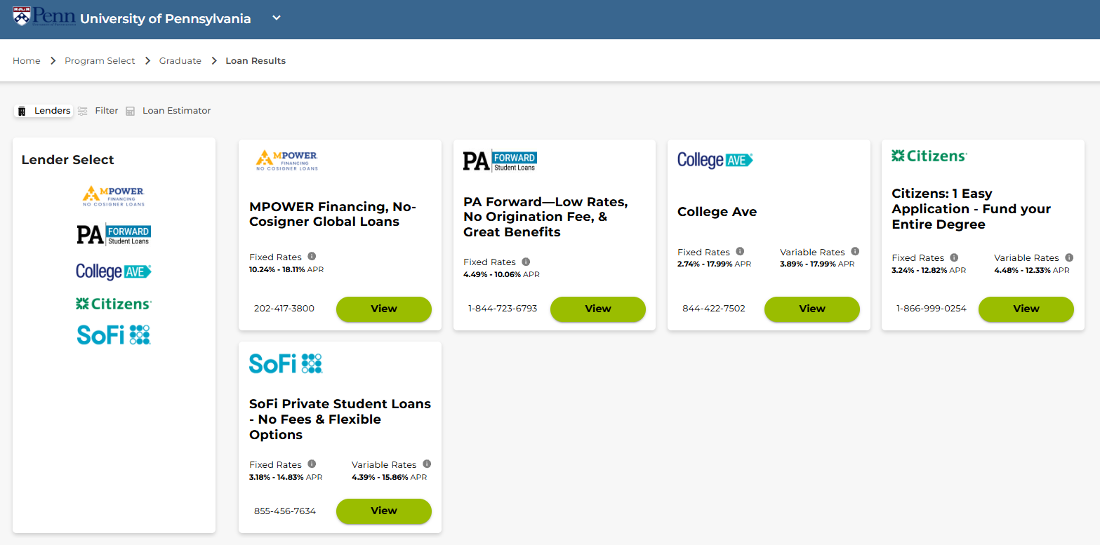
UPENN Private Student Loan Options
Notes:
Continuation of UPenn lender options. Students should carefully evaluate long-term repayment flexibility, interest rate types, and co-signer release policies. Private loan structures vary significantly and require careful comparison. PLEASE REMEMBER while UPENN did a fantastic job and drilling down lenders that will work fantastically for you if you have another lender in mind please do not hesitate to try and use them. You are allow to borrow from whoever you like.

Slide 12






Why Private Student Loans?
There may be a gap in financing after accepting financial aid awards and exhausting the student’s Federal loan options.
Reasons for choosing a private student loan are:
Avoid Origination Fees
Avoid Prepayment Penalties
Be rewarded with lower rates for good credit
Give financial responsibility to the student
Help build a credit portfolio for the student
Private student loan lenders let borrowers apply with a co-signer to increase chances for approval and help students qualify for a better interest rate
Notes:
“Because of the new federal loan caps, many students will encounter a funding gap—this is where private loans become an important option.” “Reasons students may choose private loans include: Lower rates for borrowers with strong credit
No origination fees
No prepayment penalties
The ability for the student/borrower to build credit”
“Co‑signers can greatly improve approval rates and interest rates for students with limited credit histories.”
“Private loans aren’t for everyone, but they are a strategic tool for filling the gap after federal options are exhausted.”

Slide 13
Thank You

Slide 14
Disclosures
1 Student Lending Eligibility Criteria: Applicants must be a U.S. citizen, permanent resident, or eligible non-citizen with a creditworthy U.S. citizen or permanent resident co-signer. For applicants who have not attained the age of majority in their state of residence, a co-signer is required. Citizens reserves the right to modify eligibility criteria at any time. Citizens private student loans are subject to credit qualification, completion of a loan application/Promissory Note, verification of application information, and if applicable, self-certification form, school certification of the loan amount, and student's enrollment at a Citizens participating school.
2 Student Loan Eligibility: Applicants must be enrolled at least half-time in a degree-granting program at an eligible institution.
Citizens Student Loan for Parents Eligibility: The student whose education expenses will be paid for with the loan proceeds must be a U.S. citizen or permanent resident and must be enrolled at least half-time in a degree granting program at a Citizens-participating school.
Student Loan Eligibility: Applicants must be enrolled at least half-time in a degree-granting program at an eligible institution.
3 Multi-Year Approval: Funds available for future use are subject to a soft credit inquiry at time of your next request to verify continued eligibility. After we make the initial Loan to you, you must continue to meet eligibility criteria to obtain additional funds under the Multi-Year Approval feature. Terms and conditions are outlined in the promissory note. Multi-Year Approval borrowers have a 99% approval rate on future requests for additional funds. The additional funds approval rate is based on the percentage of approved Multi-Year borrowers from Citizens between October 1, 2023 and October 1, 2024. The approval rate represents only borrowers who had previously accepted the Multi-Year Approval offer. Please Note: International students are not eligible for Multi-Year Approval.
4 Loyalty Discount: The borrower will be eligible for a 0.25 percentage point interest rate reduction on their loan if the borrower or their co-signer (if applicable) have a qualifying account in existence at the time of application completion. The following are qualifying accounts: personal checking, personal savings, personal credit card or previous student loans owned by Citizens Bank, N.A. Please note, our checking and savings account options are only available in the following states: CT, DC, DE, FL, MA, MD, MI, NH, NJ, NY, OH, PA, RI, VA, and VT and some products may have an associated cost. This discount will be reflected in the interest rate disclosed in the Loan Approval Disclosure that will be provided to the borrower once the loan is approved. Limit of one Loyalty Discount per loan and discount will not be applied to prior loans. The Loyalty Discount will remain in effect for the life of the loan.
5 Automatic Payment Discount: Borrowers will be eligible to receive a 0.25 percentage point interest rate reduction on their student loans owned by Citizens Bank, N.A. during such time as payments are required to be made and our loan servicer is authorized to automatically deduct payments each month from any bank account the borrower designates. Discount is not available when payments are not due, such as during forbearance. If our loan servicer is unable to successfully withdraw the automatic deductions from the designated account three or more times within any 12-month period, the borrower will no longer be eligible for this discount.
6 Citizens Scholarship: No purchase necessary. Void where prohibited. The Citizens Scholarship Sweepstakes is open to legal residents of the 50 United States, D.C., and U.S. Territories, who are 18 years of age or older, are students, or prospective students, or parents or legal guardians of students intending to enroll or enrolled at least half-time in an accredited undergraduate/graduate post-secondary institution. To be eligible for a chance to win for the Citizens Building the Workforce of the Future Scholarship entrants must be from an underrepresented or a low-income community as described in the Official Rules. Sweepstakes begins at 12:00 AM ET on 4/1/25 and ends at 5:00 PM. ET on 3/31/26. Sponsored by Citizens. For Official Rules, visit Citizensbank.com/scholarship.
© 2025 Citizens Financial Group, Inc. All rights reserved. Member FDIC

